Slide 1
UB Hacking 2023
- Eugenia Vance
- Akash Ponduru

Slide 2
We Built
“Course Roster Generator”
What it does?
It takes a bunch of input data and prepares a draft course allocation plan which is helpful for course advisors to assign classes and Professors to Students.

Slide 3
There are some limitations though,
- Its not intelligent, It utilizes the information provided by users to satisfy the restraints provided. With restraints being:
- How many sections of a class are available.
- Class size (Not all class size are equal).
- It does not have any concept of Time, So It cannot create plans for weeks or months.
- Its not guaranteed that all students will be allocated a class or section.
But the good part is,
- It creates an initial blueprint which saves a lot of time for anyone who does not want to deal with too many spreadsheets.

Slide 4
How it works?
It needs two csv files from you, template provided in the repository. The files doesn’t necessarily have to have same name, but the program requires the schema of these files to be same.
- Professors Inputs.csv
- Students Inputs.csv

Slide 5
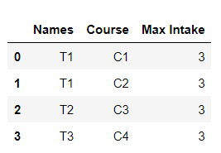
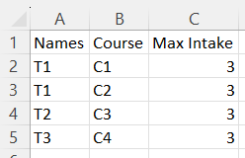
Professors Inputs.csv
Column Names | Column Description
Names | Names of the Professors
Courses | Course which Professor is going to teach
Max Intake | Max Intake size of that class.
Notes:
- If a Professor is taking multiple courses, then each courses needs to be in different row. In the sample table Professor T1 is taking Course C1 and C2; Therefore, each course is in different row.
- Max Intake size does not need to be constant.
(CSV input)
(CSV to table)

Slide 6
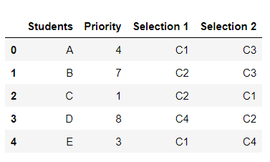
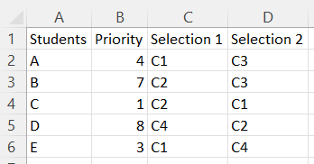
Students Inputs.csv
Column Names | Column Description
Students | Names of the Students
Priority | Order in which Students have registered for the course
Selection 1 | Students course choice 1
Selection 2 | Students course choice 2 (Should be different from Selection 1)
Example:
- Student B and Student C both have Course C2 in their Selection 1, but Student C will be given first preference since Student C has higher priority number or the number implies that Student C has registered first.
(CSV Input)
(CSV to table)

Slide 7
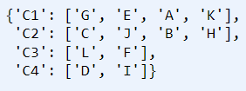
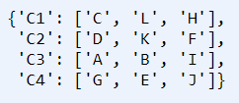
Next Steps..
It takes columns Students, Selection 1 and Selection 2 and convert them into 2 dictionaries as shows below
Dict1 = Keys are courses in Selection 1 and values are the list of students asking to be registered for that Course in order of Priority.
Dict2 = Keys are courses in Selection 2 and values are the list of students asking to be registered for that Course in order of Priority.
(A sample input table)
Dict1 = {Selection 1 Courses : Students}
Dict2 = {Selection 2 Courses : Students}

Slide 8
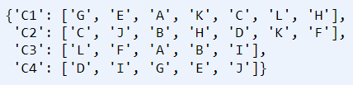
Next Steps..
Dict1 = {Selection 1 Courses : Students}
Dict2 = {Selection 2 Courses : Students}
Dict3 = Merged list of Students From Dict1 and Dict2.

Slide 9
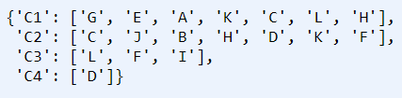
Next Steps..
Dict3 = Merged list of Students From Dict1 and Dict2.
Note:
Some students do appear twice in the values that’s because they might have selected those courses as Selection 2, So if any student from first 3 places is going to drop class, they will get the opportunity to take that class.
Dict4 = Modified Dict3 such that Students are not assigned multiple courses.

Slide 10
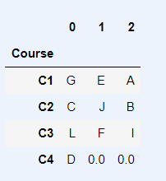
Next Steps..
The Dict4 will use the information Max Intake to create the output table as shown, Since Max Intake for each class was 3, top 3 allocated students from each course were finally assigned to the courses.
Note:
- Course C4 is only assigned 1 student.
But why?
Dict4 = Modified Dict3 such that Students are not assigned multiple courses.
(Output table)

Slide 11
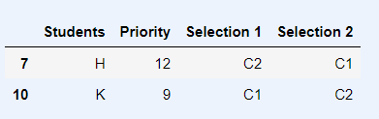
Which Students are not assigned classes?
Note:
- Course C4 is only assigned 1 student.
But why?
Since Student H and Student K did not choose Course C4 in either of their selections and they were on lower priority, they were not assigned any classes. That’s where Program advisors can take up and assign courses to them based on the available slots in each Course.
(Output table)

Slide 12
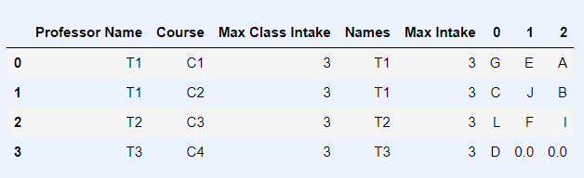
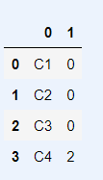
That’s all?
Well, we can see the Final table which has consolidated information and the empty slots available in each courses.
(Output table)
(Final table)
(Remaining Slots)

Slide 13
Questions?

Slide 14
Thank You!

